Slide 1

Graded Team Assignment: Gender Discrimination Lawsuit
Group 7

Slide 2
Key Claims
Claim | Salary Disparity | Promotion Gap
Argument | Females at the school earn less money than men, on average. | Female faculty at the school are less likely to be full professors, more likely to be assistant professors.
Target Data | Salary 1994, Salary 1995 | Rank

Slide 3
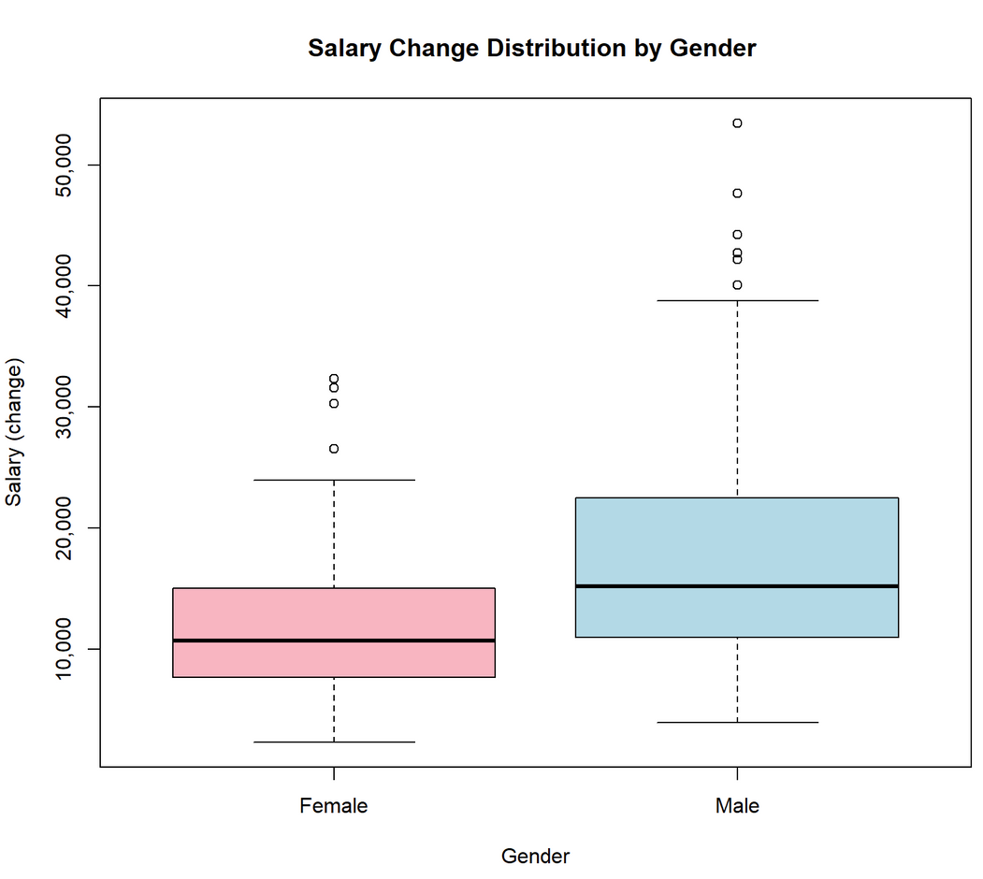
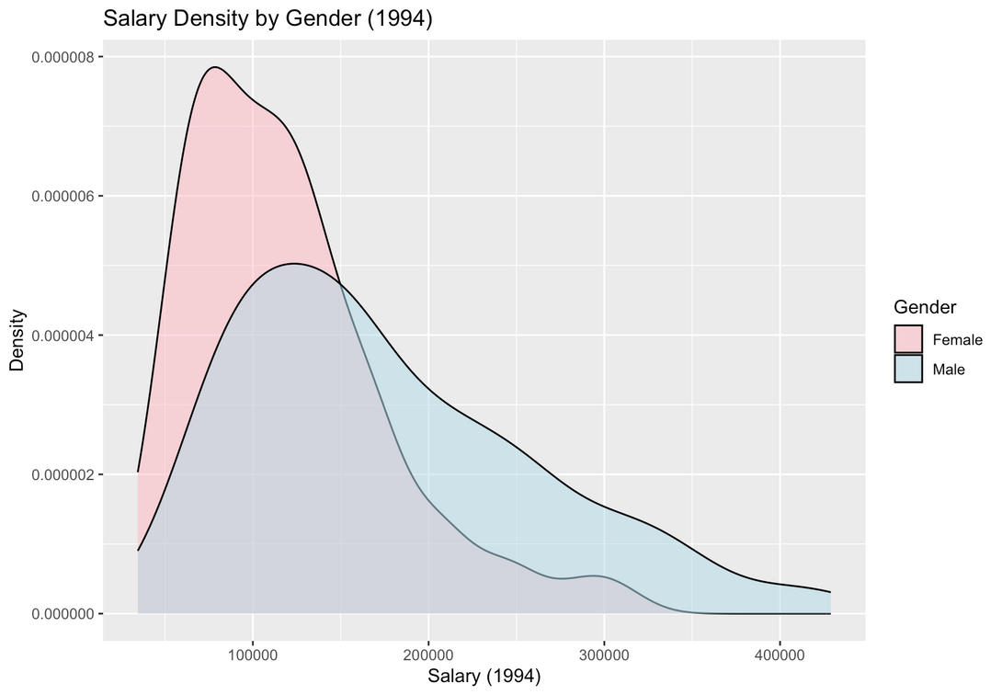
Females have lower salaries and less salary increments

Slide 4
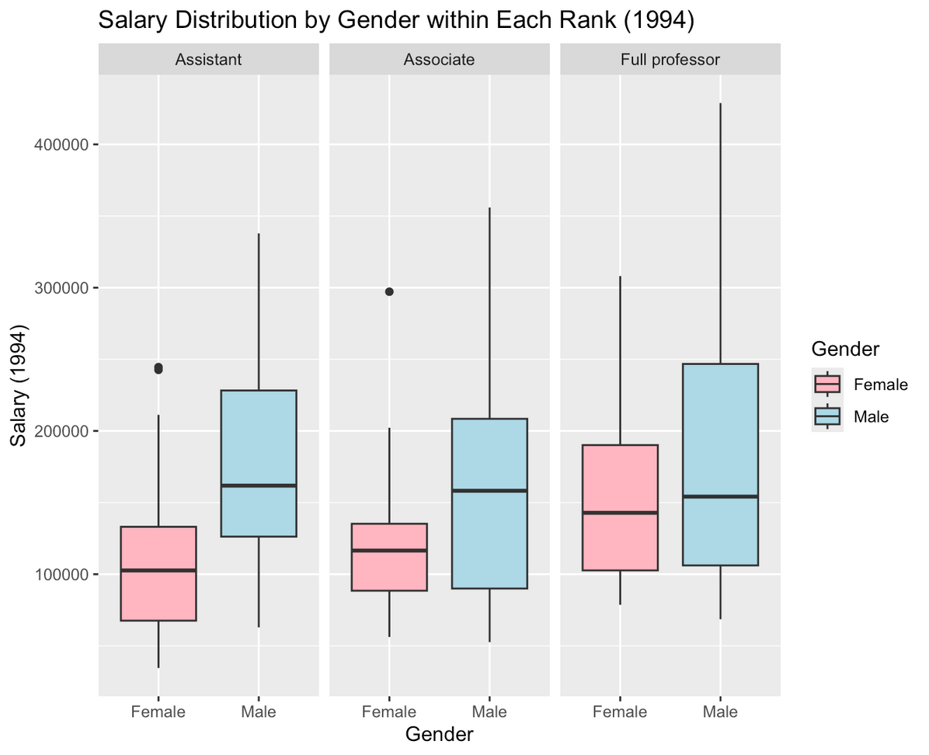
Females earn less than males at the same rank, even at the top 25%

Slide 5
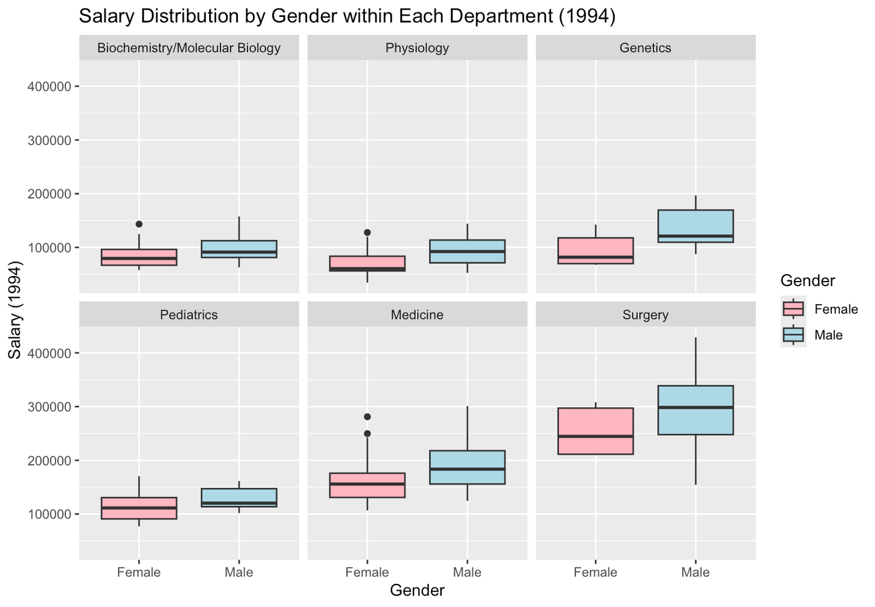
Females consistently earn less than males
across all departments

Slide 6
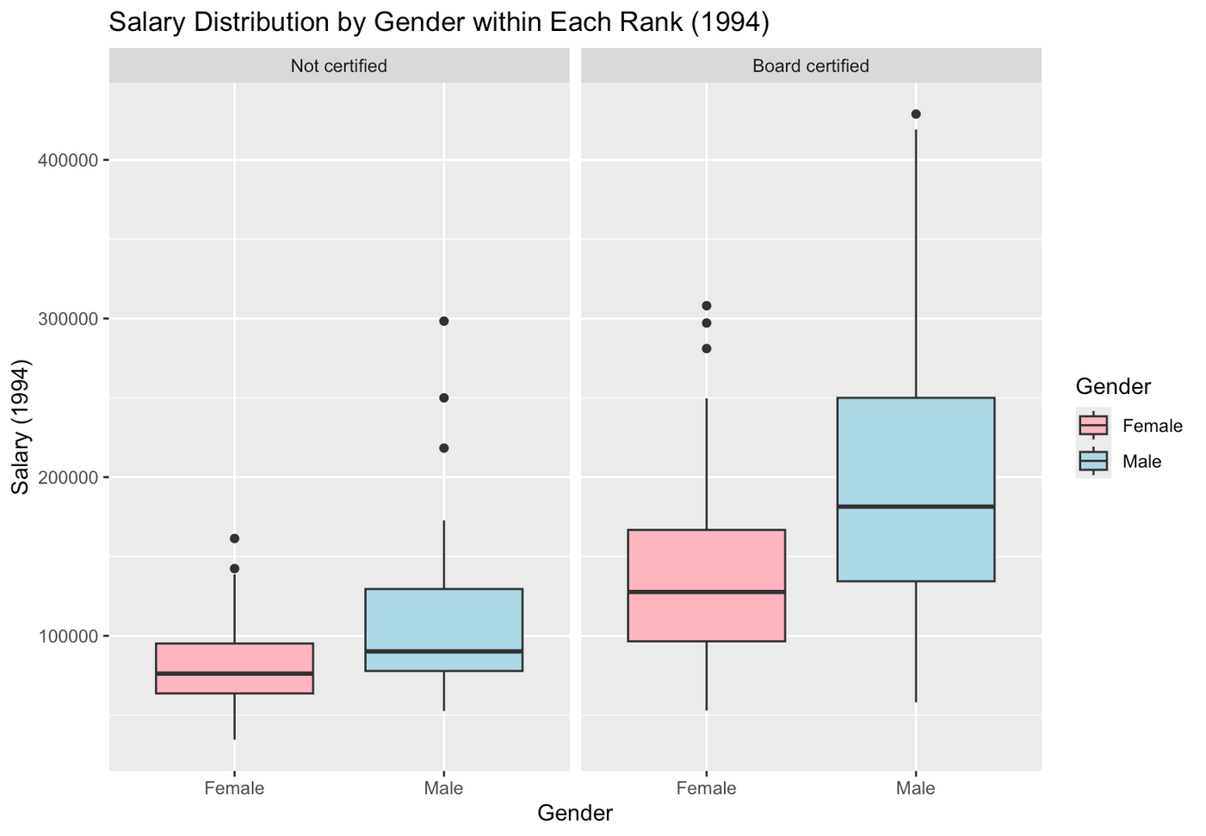
Provided the same certification, females earn less than males

Slide 7
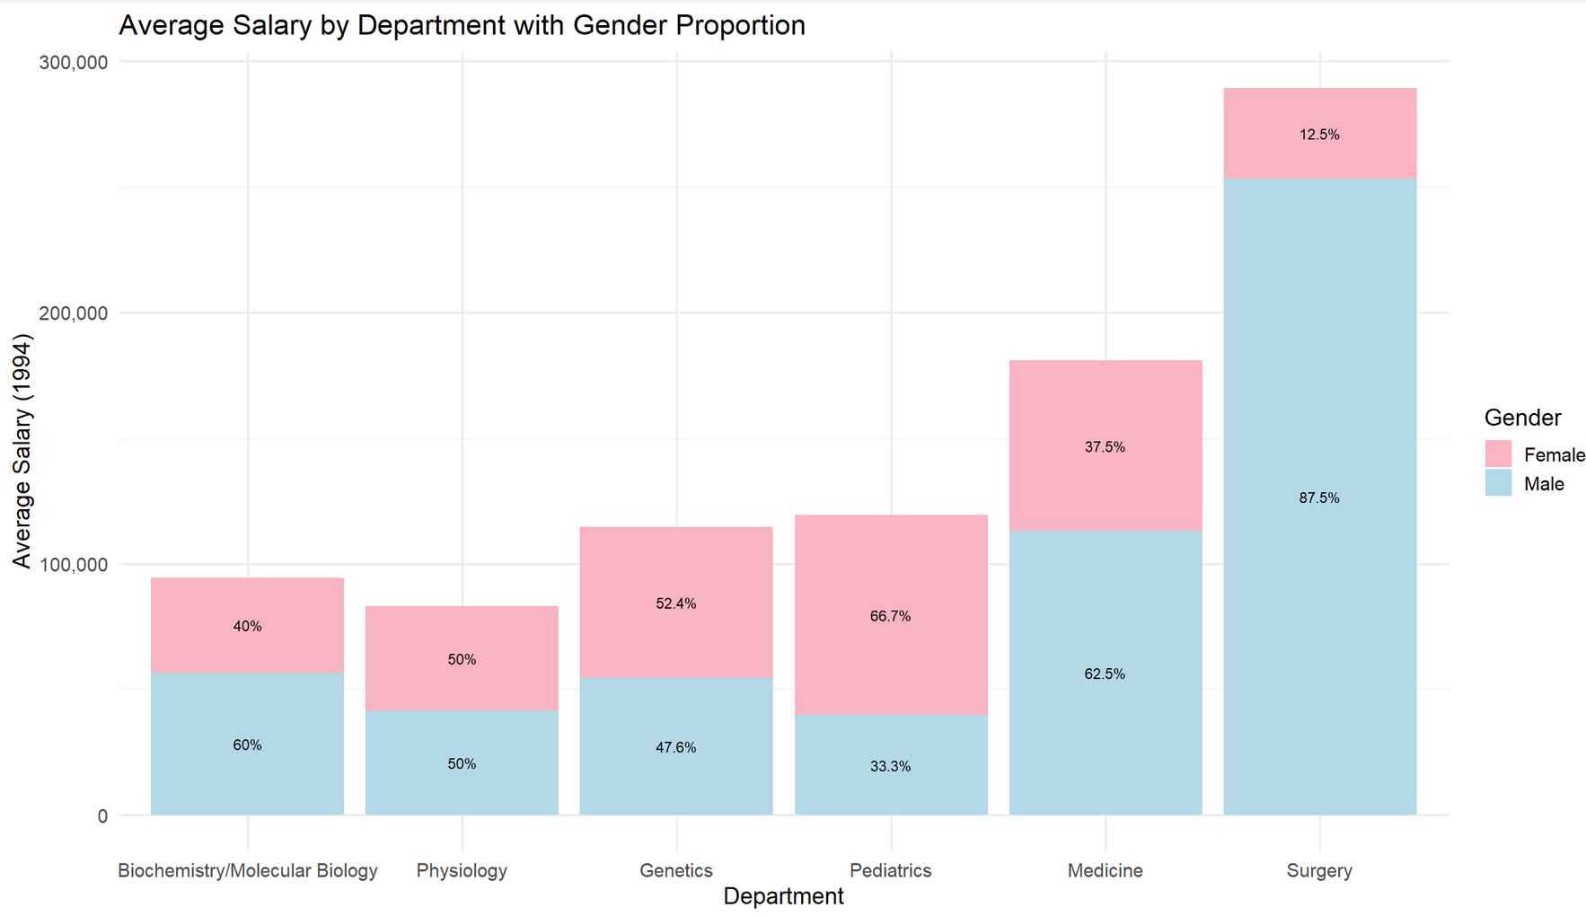
Surgery has the highest-paying department, yet it has the lowest proportion of females

Slide 8
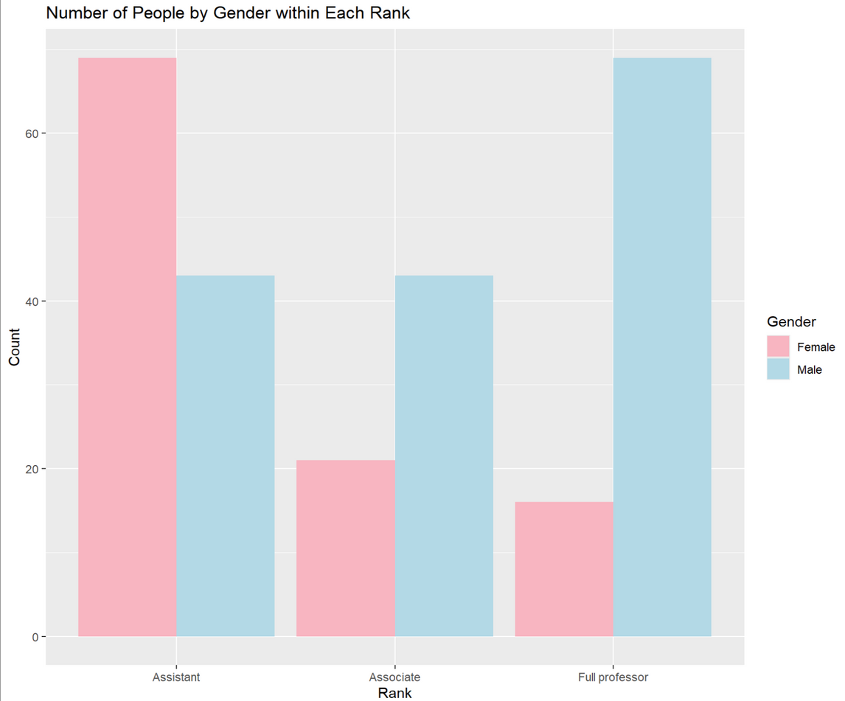
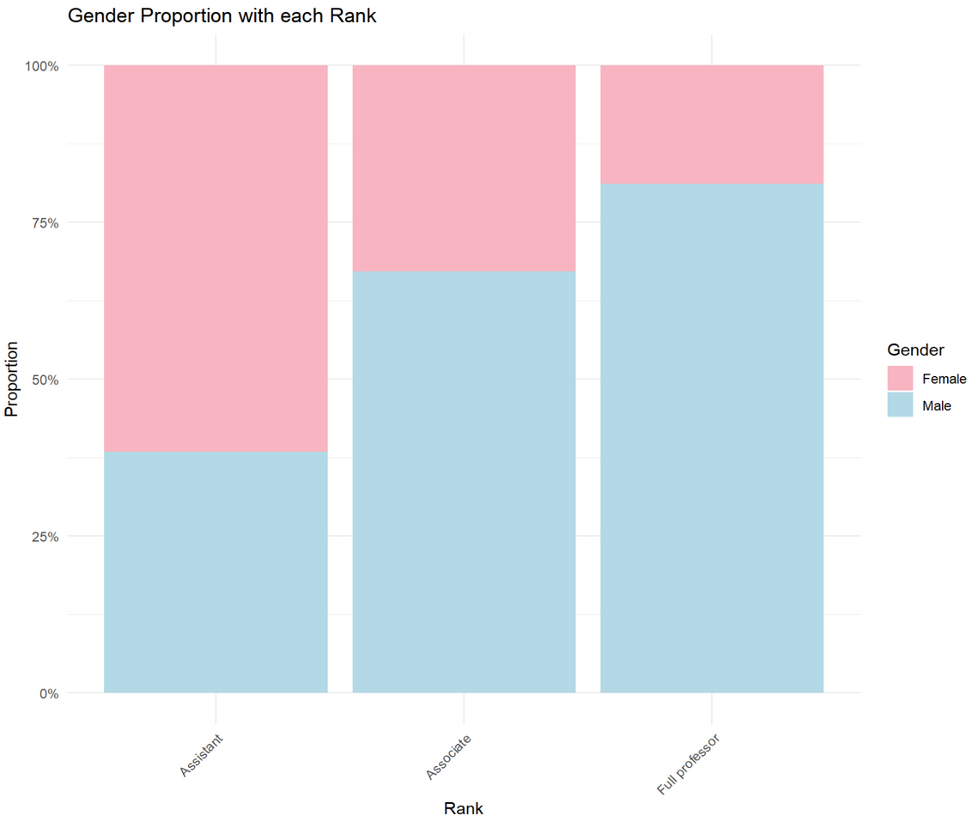
Males are more likely to be full professor, leading to higher average earnings

Slide 9
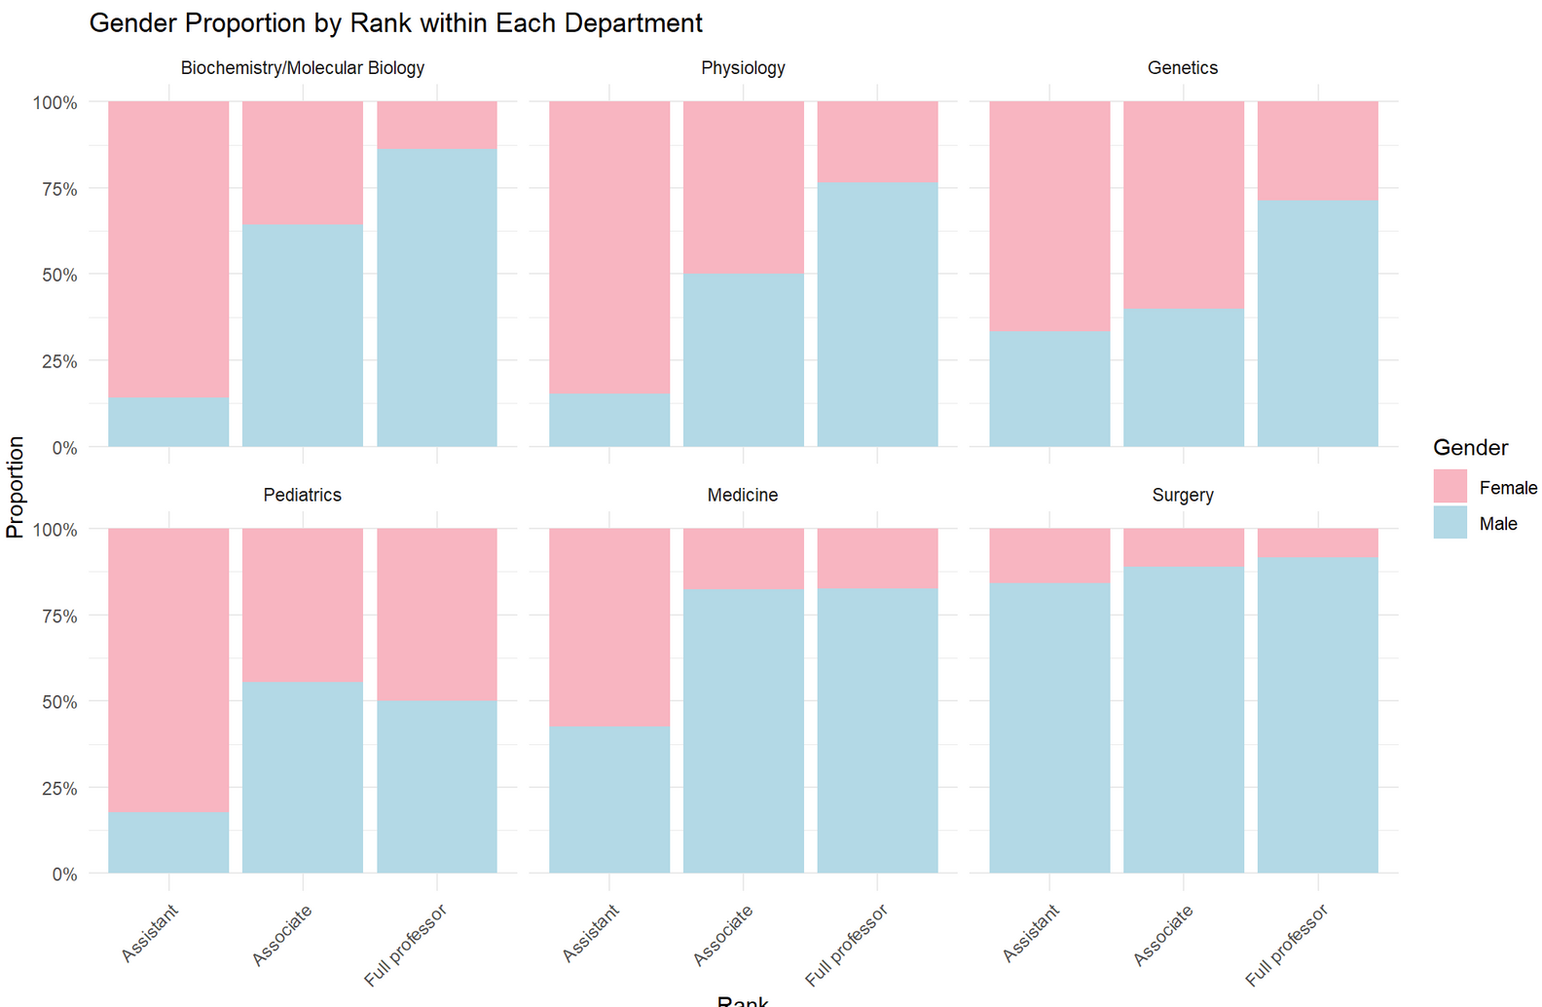
Gender Proportion of Rank in each Department

Slide 10
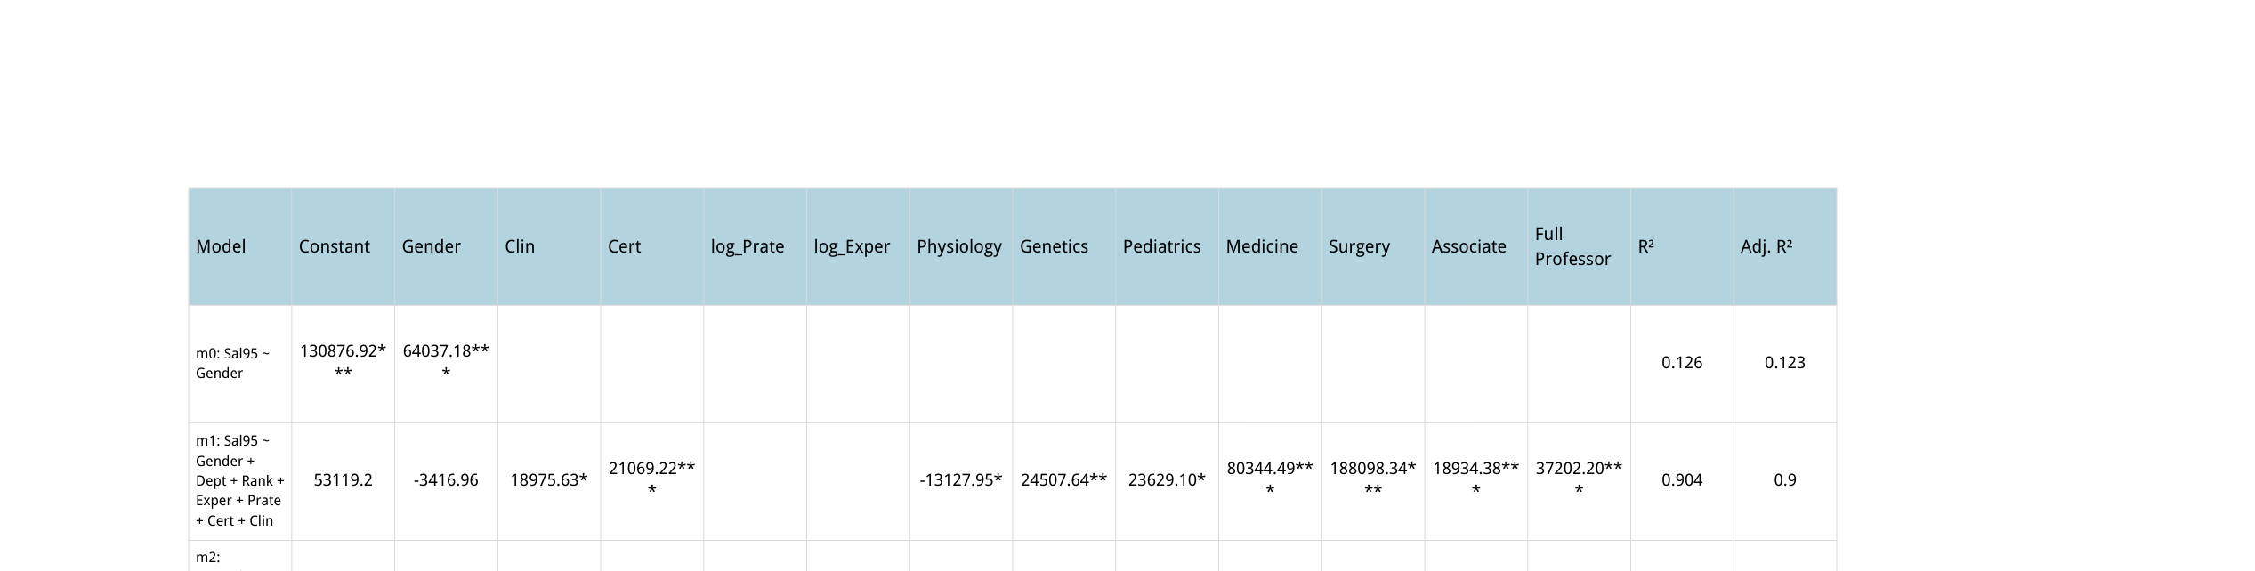
All Departments — Salary levels (OLS)
*** Model used: linear regression
* represents the level of significance: * p<.05, ** p<.01, *** p<.001;
log-model % ≈ 100·(exp(β)−1)

Slide 11
What the OLS models show (m0–m3)
m0 (Sal95 ~ Gender): Men earn +$64k (p < .001).
m1 (+ Dept + Rank + Exper + Prate + Cert + Clin): Gender n.s.; Experience ≈ +$3.3k/year; large Department and Rank effects (R² ≈ 0.90).
m2 (log Sal94, with Rank): Gender n.s.; strong Dept/Rank and log-Experience effects (R² ≈ 0.93).
m3 (log Sal94, no Rank): Gender β = 0.0466* → ≈ +4.8% male premium (R² ≈ 0.92).
Takeaway:
The overall gap is mostly explained by department & rank composition.
Within-structure differences are small—only a modest ~4–5% male premium appears when Rank is dropped to reduce multicollinearity.

Slide 12
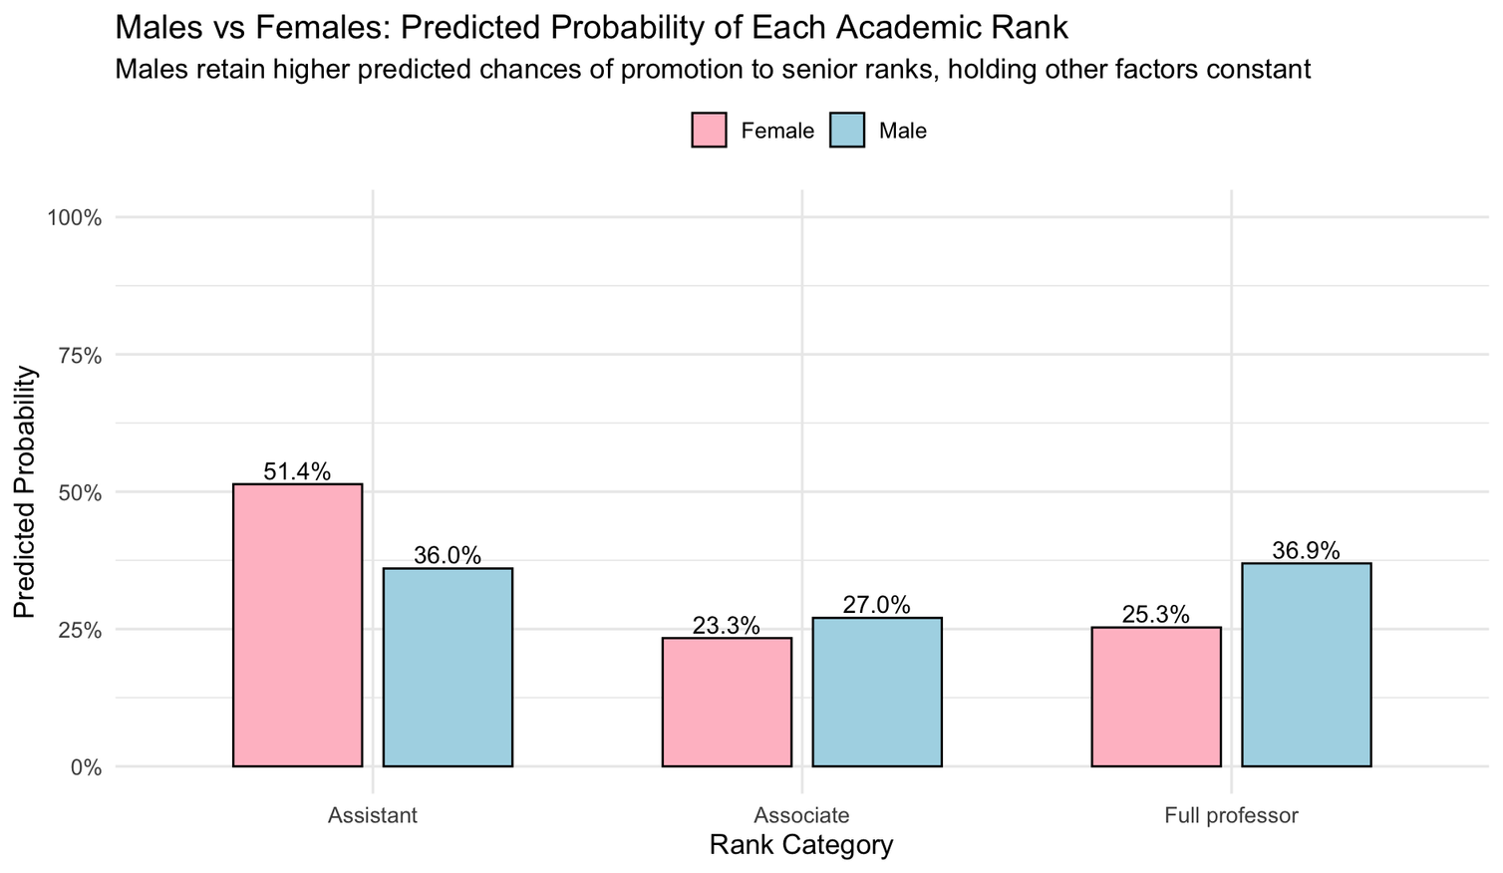
Climbing the Ladder: Males have higher chances of reaching higher academic ranks
Overall accuracy: 69.7%
Industry benchmarking: 69 - 73%
*** Model used: multi-logistic regression

Slide 13
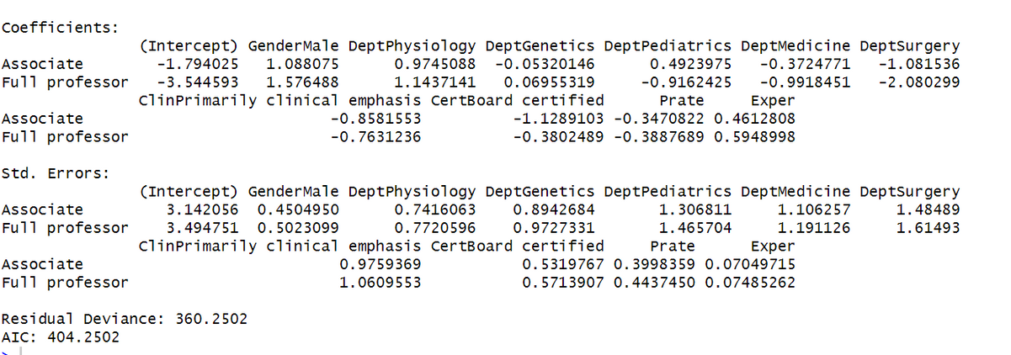
Appendix
Multilogistic regression output
The p-value of the log-odds-ratio for associate is 0.0157, and 0.00170 for full professor, which suggests that gender is a significant variable in the model.

Slide 14
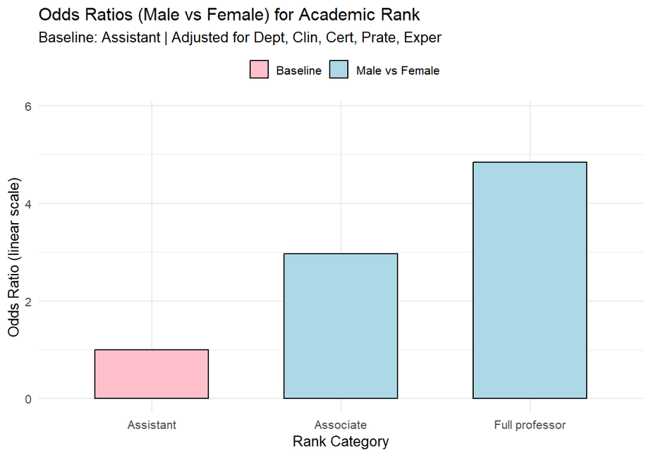
Appendix
Odds ratio comparison against baseline group
Using Rank as the target variable and the rest as predictor variable, we found that:
Keeping other variables constant, being a male increase the relevant chance of becoming an associate professor by about 2 times, and are nearly 4 times more likely to become a full professor.

Slide 15
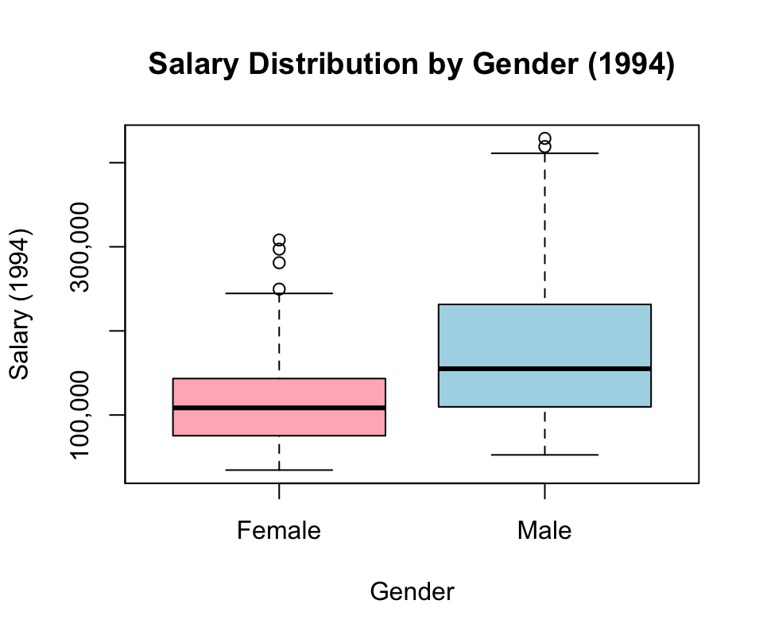
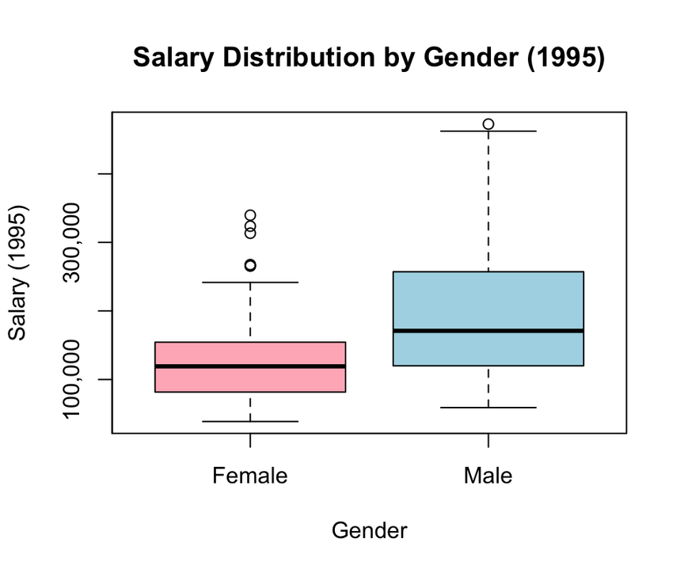
Females are paid less than males

Slide 16





Using Rank as the target variable and the rest as predictor variable, we found that:
Keeping other variables constant, being a male increase the relevant chance of becoming an associate professor by about 2 times, and are nearly 4 times more likely to become a full professor.
Studio Shodwe
Pitch Deck Presentation
Redefining Everyday Indulgence
Presented By:
Avery Davis
www.reallygreatsite.com

Slide 17






Studio Shodwe
The Opportunity
Consumers crave sensory experiences with design at the core
Taste, convenience, and quality are expected as one
Everyday indulgence is now a lifestyle, not a luxury

Slide 18

salary increment

Slide 19








Studio Shodwe
Who We Are
A creative brand merging artisanal flavor with modern design
Transforming ordinary moments into curated experiences
Redefining taste with innovation and elegance
www.reallygreatsite.com

Slide 20




Our Signature Products
Where Flavor Meets Artful Design
Our signature offerings include daily indulgence collections, limited-edition sensory kits, and art-driven packaging designed to be cherished as much as consumed.

Slide 21





What Makes Us Unique
Crafted with Art, Elevated with Care
What makes us unique is the fusion of culinary craftsmanship with artful presentation, collaborations with creative experts, and a commitment to elevated yet sustainable details.

Slide 22









Aesthetic-focused Millennials & Gen Z
Urban professionals and creatives seeking meaningful treats
Retail partners drawn to storytelling and experiential design
Target Audience

Slide 23





Market Potential
Rising demand for premium self-gifting and daily indulgence
Wellness, lifestyle, and design converging in the market
Positioned for niche appeal with scalable production

Slide 24



Channels & Growth
Expanding Through Curated Connections
Our growth channels span direct-to-consumer platforms, boutique retail and lifestyle stores, and custom collaborations for events, gifting, and limited editions.

Slide 25






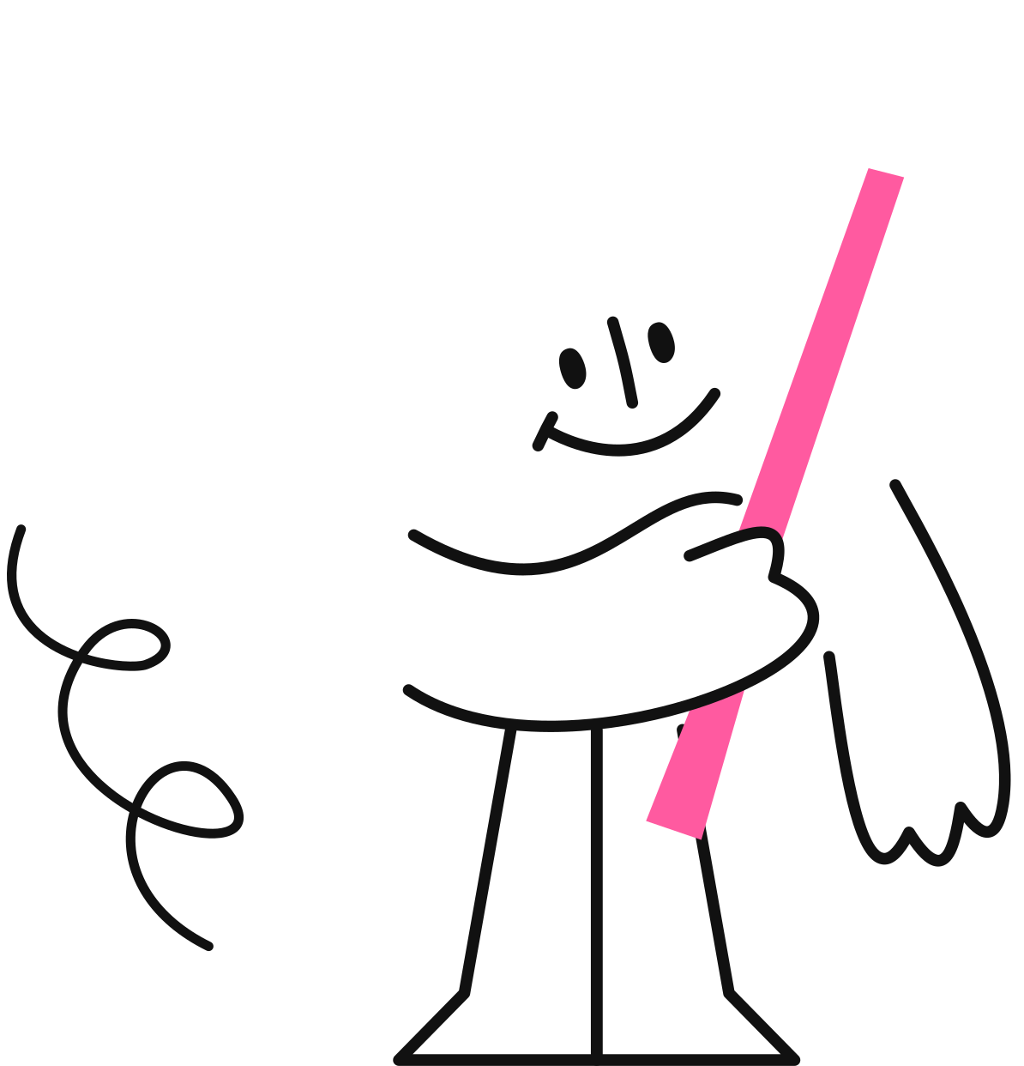
Studio Shodwe
Vision Forward
Building an ecosystem of sensory design and daily pleasure
Expanding into intersections of taste, touch, and aesthetics
Becoming the brand for unforgettable everyday experiences

Slide 26








Studio Shodwe
@reallygreatsite
Thank You
Very Much
reallygreatsite.com
123 Anywhere St., Any City

Slide 27












Resource Page
Use the following design resources in your training presentations. Happy designing!

Slide 28












Resource Page
Use the following design resources in your training presentations. Happy designing!

